Slide 1
Association Between Oral Health and Dietary Habits in US Adults: An Analysis of NHANES Data
BMIN503 Final Project
Kira Nightingale, MS, MBA
December 3, 2021

Slide 2
Project Overview
The primary objective of this project was to determine whether dietary habits impact oral health in US adults
Data source: National Health and Nutrition Examination Survey 2015-2016 and 2017-2018
Demographic information
Dental exam
Nutrition survey

Slide 3
Oral Health as a Public Health Issue
Approximately 3.5 billion individuals worldwide suffer from oral health conditions¹
In 2010, these conditions resulted in direct and indirect global losses of $442 billion
Indirect losses estimated at $144 billion, within the range of losses caused by top ten global causes of death
Indirect losses due to cancer: $859 billion
Indirect losses due to lower respiratory infections: $126 billion²
Prevention programs mostly targeted at children, although burden of disease falls primarily on adults in middle- and high-income countries^{3, 4}

Slide 4
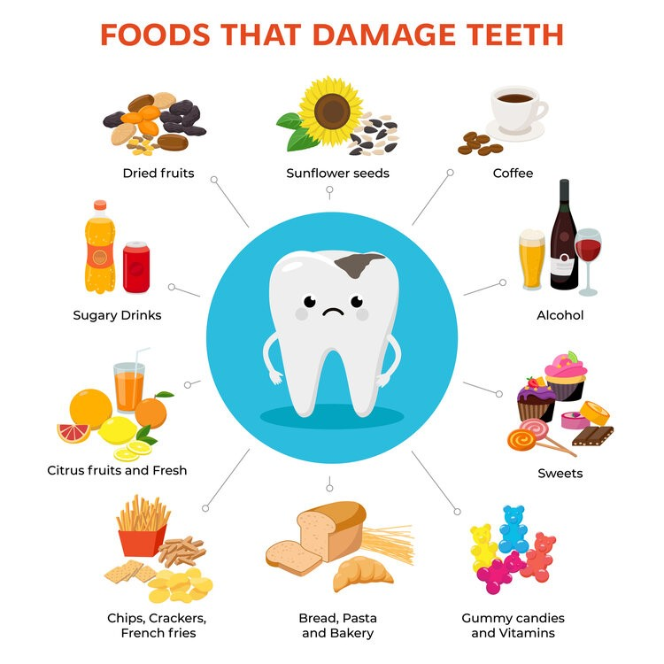
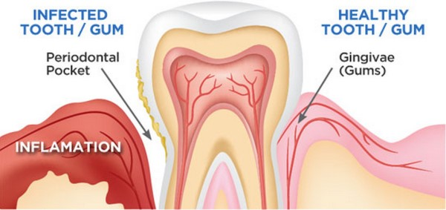
Nutrition and Oral Health
Consumption of sugar and carbohydrates alters the oral pH, promoting cariogenic bacteria growth⁵
Calcium and vitamin D (which is necessary for calcium absorption) are important for tooth health, particularly in children⁶
Inadequate protein and vitamin C have been linked to periodontal disease, which can result in exposed root surfaces that are vulnerable to caries development⁷
Image credits: https://stthomassource.com/wp-content/uploads/sites/2/2020/10/foods-that-damage-teeth-2.jpg
https://harvardrddentalcare.com/services/dental-procedures/dental-cleanings/

Slide 5
Methods
Descriptive statistics of demographic information
Decayed, missing, filled tooth (DMFT) score was calculated for each participant by summing teeth with prior/current caries
DMFT was square-root transformed for inclusion in linear regression
Nutrition information for each participant was converted into percent of the daily recommended value based on sex and age⁸
Logistic regression – risk factors for DMFT of 0 vs. non-0
Linear regression – among non-0 DMFTs, risk factors for higher DMFT scores

Slide 6
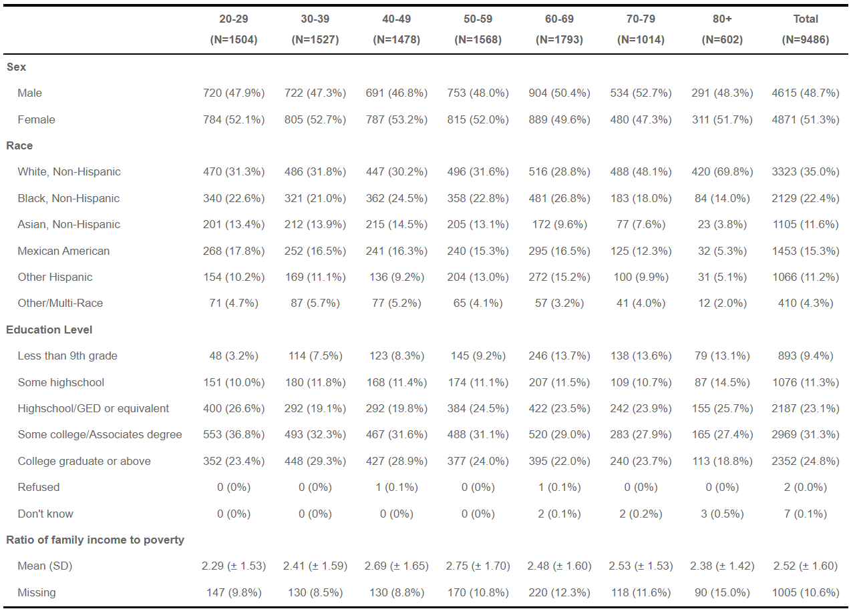
Demographic Characteristics

Slide 7
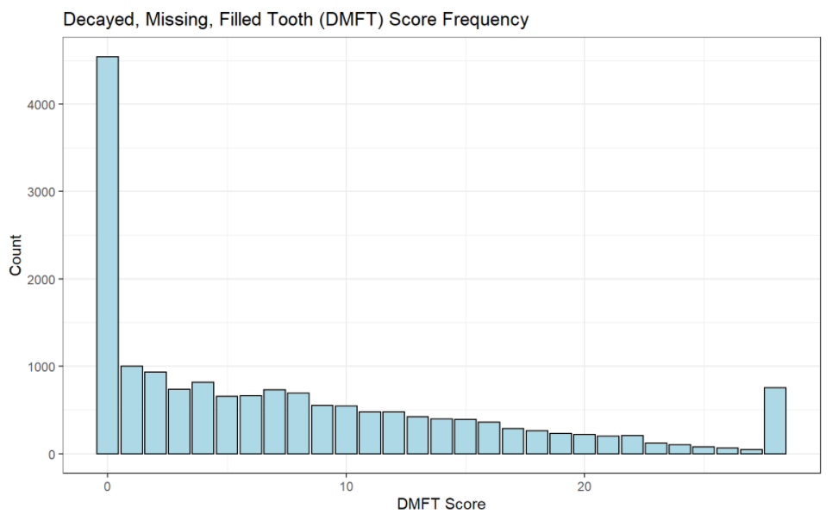
Dental Examination
Decayed, Missing, Filled Teeth (DMFT) score sums all teeth with prior or current cavitation
Scores range from 0-28 (third molars not included in calculation)
Scores can never decrease over time

Slide 8
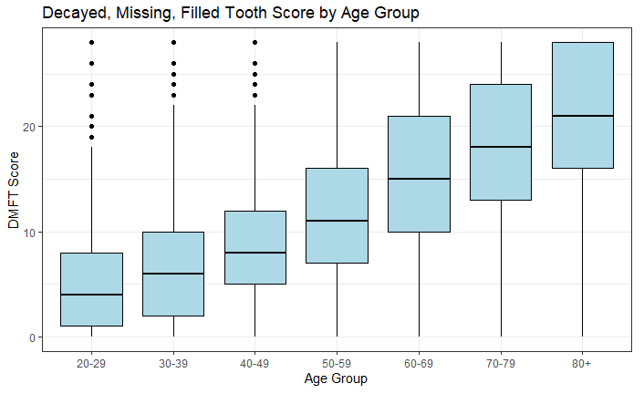

Slide 9
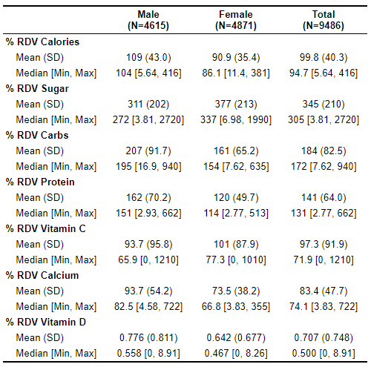
Nutrition Analysis

Slide 10
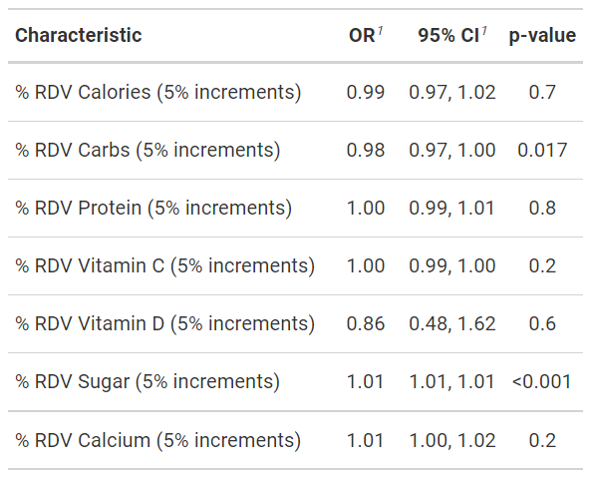
Logistic Regression: Risk Factors for DMFT>0
Analysis controlled for age, sex, race, education, and household income
Sugar significantly associated with DMFT>0
For every 5% of the RDV of sugar consumed, likelihood of having at least one cavity increases by 1%
Remember: participants consumed more than 300% of the RDV of sugar!

Slide 11
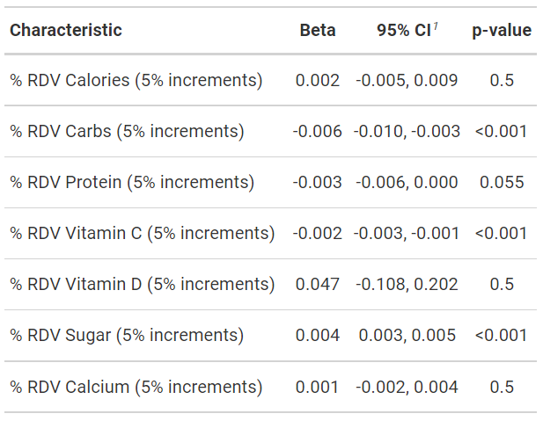
Linear Regression: Risk Factors for Higher DMFT Score
Analysis controlled for age, sex, race, education, and household income
Quantity of sugar consumption increased likelihood of having a higher DMFT score
Quantity of vitamin C consumption decreased likelihood of having a higher DMFT Score

Slide 12
Conclusions
Sugar consumption plays an important role in caries development
Vitamin C consumption is potentially protective against caries
The strongest predictor of number of caries was age, a factor that is not modifiable
Therefore, identification of other risk factors that could be targeted for intervention is vital

Slide 13
Limitations
Nutrition recall is notoriously unreliable
Frequency of nutrient consumption was not considered
Use of multivitamins was not considered
Separate logistic and linear regressions were performed for ease of interpretation, although a zero-inflated negative binomial regression would have been more robust
Future studies: Dietary change is hard! Can oral hygiene mitigate detrimental effects of diet?

Slide 14
References
1. Bernabe E, Marcenes W, Hernandez CR, et al. Global, Regional, and National Levels and Trends in Burden of Oral Conditions from 1990 to 2017: A Systematic Analysis for the Global Burden of Disease 2017 Study. Journal of Dental Research. 2020;99(4):362-373. doi:10.1177/0022034520908533
2. Listl S, Galloway J, Mossey PA, Marcenes W. Global Economic Impact of Dental Diseases. Journal of Dental Research. 2015;94(10):1355-1361. doi:10.1177/0022034515602879
3. Petersen, PE, Baez, RJ, Ogawa, H. Global application of oral disease prevention and health promotion as measured 10 years after the 2007 World Health Assembly statement on oral health. Community Dent Oral Epidemiol. 2020; 48: 338– 348. https://doi-org.proxy.library.upenn.edu/10.1111/cdoe.12538
4. Lagerweij, M.D., van Loveren, C. Declining Caries Trends: Are We Satisfied?. Curr Oral Health Rep 2, 212–217 (2015). https://doi-org.proxy.library.upenn.edu/10.1007/s40496-015-0064-9
5. Shailesh M. Gondivkar, Amol R. Gadbail, Rima S. Gondivkar, Sachin C. Sarode, Gargi S. Sarode, Shankargouda Patil, Kamran H. Awan. Nutrition and oral health. Disease-a-Month. 2019; 65(6): 147-154.
6. Schroth, R.J., Levi, J.A., Sellers, E.A. et al. Vitamin D status of children with severe early childhood caries: a case–control study. BMC Pediatr 13, 174 (2013). https://doi.org/10.1186/1471-2431-13-174
7. Hujoel, PP, Lingström, P. Nutrition, dental caries and periodontal disease: a narrative review. J Clin Periodontol 2017; 44 (Suppl. 18): S79– S84. doi: 10.1111/jcpe.12672.
8. National Institutes of Health: Office of Dietary Supplements. Nutrient Recommendations: Dietary Reference Intakes. https://ods.od.nih.gov/HealthInformation/nutrientrecommendations.aspx

Slide 15
Acknowledgements
Blanca Himes, PhD
Kevin Lynch, PhD
Jana Yablonski, RDH, PHDHP
Thank you!
Kira.Nightingale@pennmedicine.upenn.edu

